Slide 1
Pneumonia Detection using Deep Learning
Guided by, Presented by,
Prof . Deepa S.S Megha. C
HOD MCA S3
TVE20MCA-2039

Slide 2
Introduction
Pneumonia, is the leading cause of death in children under the age of ﬁve. It accounted for approximately 16% of the deaths of children under the age of ﬁve.
Older adults and people who have severe underlying medical conditions or prior cases of pneumonia seem to be at higher risk for developing more serious complications from the corona virus .
Timely detection of pneumonia in children and adults can help to fast-track the process of recovery.
One of the major factors associated with pneumonia is indoor air pollution . Apart from this, under-nutrition, lack of safe water, sanitation and basic health facilities are also major factors. Pneumonia can be caused by bacteria, fungi or viruses.

Slide 3
Existing System
There are several existing system in this area . Different versions extract different features of a pneumonic lungs, not all of them are able to give an exact output.
Rubin et al developed a CNN model to detect common thorax disease from frontal and lateral chest X-ray images. MIMIC-CXR dataset was used to perform large-scale automated recognition of these images. The dataset was split into training, testing and validation sets as 70%, 20% and 10%, respectively. Data augmentation and pixel normalization were used to improve overall performance.

Slide 4
Proposed System
Using the convolutional neural network models to accurately detect pneumonic lungs from chest X-rays, which can be utilized in the real world by medical practitioners to treat pneumonia.
These models have been trained to classify chest X-ray images into normal and pneumonia in a few seconds, hence serving the purpose of early detection of pneumonia.

Slide 5
Front End : Stremlit
Back End : Python
Modules :
Admin(User) Module

Slide 6
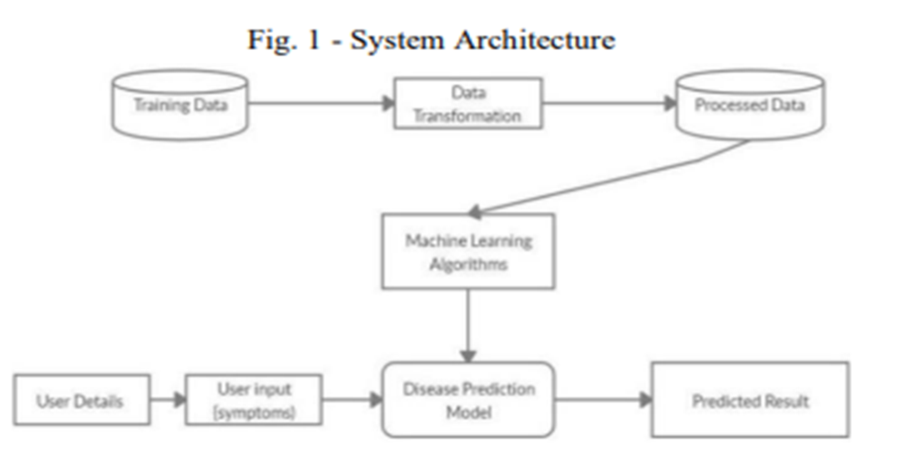
System Architecture

Slide 7
Data Flow Diagram
LEVEL 0
Pneumonia detection system
User
Enter details
response
User

Slide 8


LEVEL 1
start
Collect data
Data processing
Build model using CNN
Training dataset
Test performance
USER
Enter details
Deploy model
0
classifies
1
normal
pneumonia
end

Slide 9
Dataset
The dataset that will be used for this project will be the Chest X-Ray Images (Pneumonia) from Kaggle.
The dataset consists of training data, validation data, and testing data.
The training data consists of 5,216 chest x-ray images with 3,875 images shown to have pneumonia and 1,341 images shown to be normal.
The validation data is relatively small with only 16 images with 8 cases of pneumonia and 8 normal cases.
The testing data consists of 624 images split between 390 pneumonia cases and 234 normal cases

Slide 10
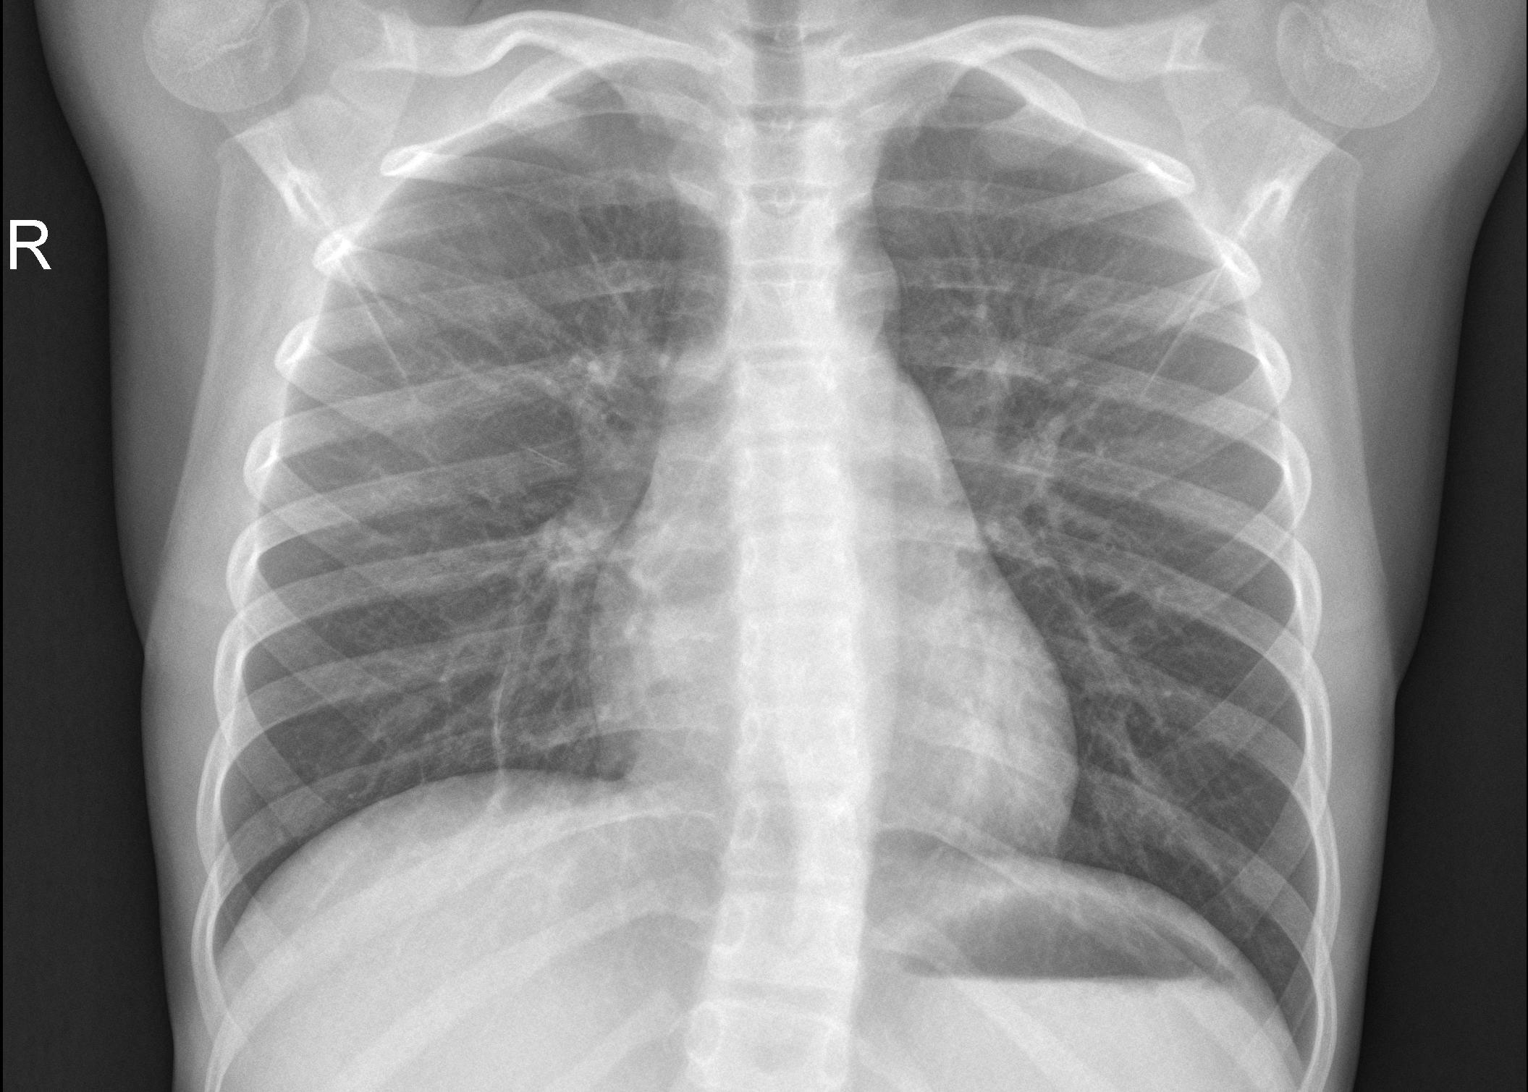
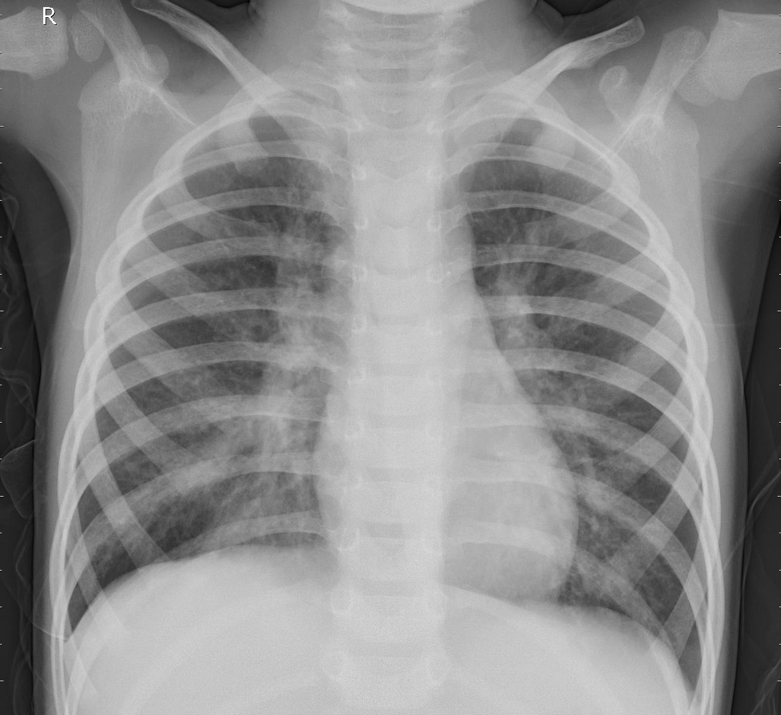
Sample Data
NORMAL
PNEUMONIA

Slide 11
Convolutional Neural Network (CNN)
A Convolutional Neural Network is a Deep Learning algorithm which can take in an input image, assign importance to various aspects/objects in the image and be able to differentiate one from the other.
Convolutional neural networks are composed of multiple layers of artificial neurons.
Artificial neurons, a rough imitation of their biological counterparts, are mathematical functions that calculate the weighted sum of multiple inputs and outputs an activation value.
When you input an image in a CNN , each layer generates several activation functions that are passed on to the next layer.
Based on the activation map of the final convolution layer, the classification layer outputs a set of confidence scores (values between 0 and 1) that specify how likely the image is to belong to a “class.”

Slide 12
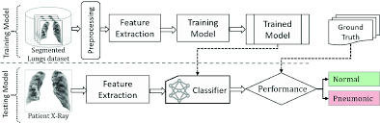
Working Of CNN

Slide 13
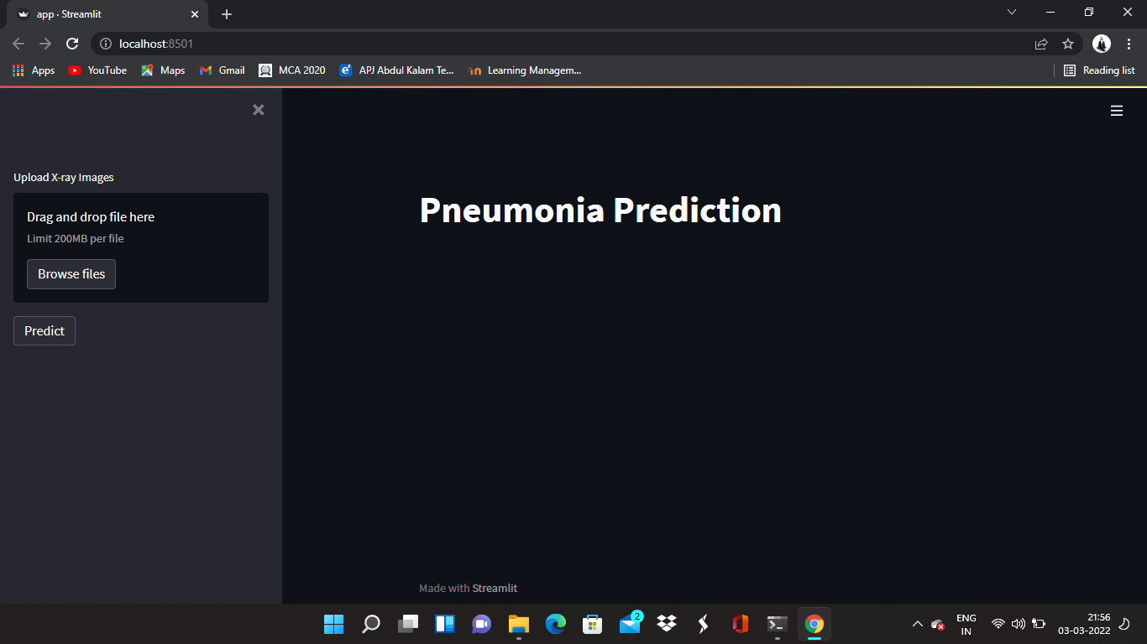
User Interface

Slide 14
Advantage of the Project
Timely detection of pneumonia
Time saving
Accurately detect pneumonic lungs from chest X-rays
Cost saving
Can be used by medical practitioners to treat pneumonia

Slide 15
References
Pneumonia Detection Using Convolutional Neural Networks (CNNs) by V. Sirish Kaushik, Anand Nayyar, Gaurav Kataria and Rachna Jain
Pneumonia Detection Using Deep Learning Based on Convolutional Neural Network by Luka Račić, Tomo Popović, Senior Member, IEEE, Stevan Čakić, Stevan Šandi

